Slide 1
5. Standard combinational modules
Fondamenti di Elettronica
Sergio Spanò – spano@ing.uniroma2.it

Slide 2
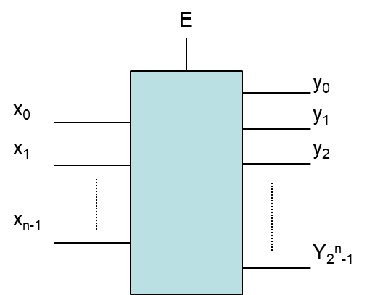
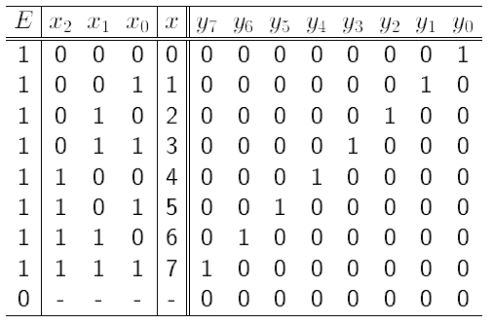
Decoder 1/2
A n-bit decoder is a combinational system having
N binary inputs X=( x_{n-1}….x₀)
2^{N} binary outputs Y=( y₂^{n-1}….y₀)
An input signal E (enable)

Slide 3
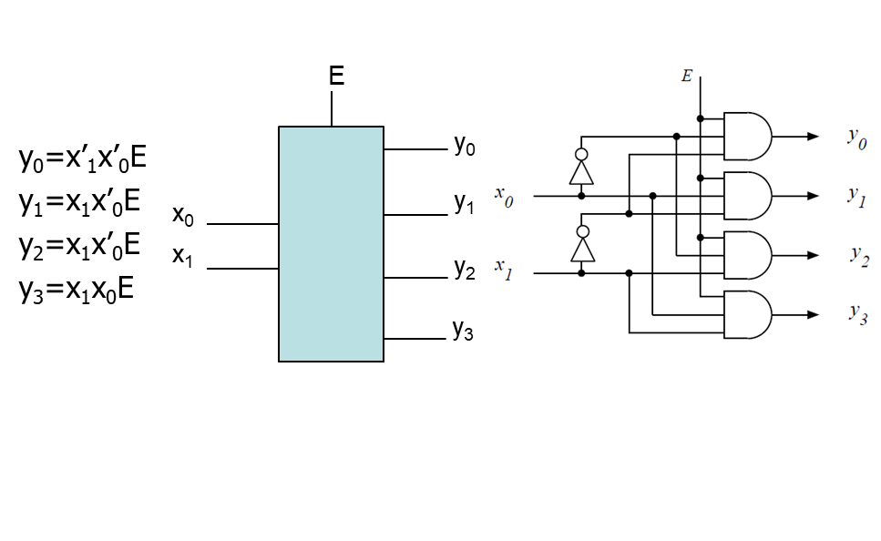
Decoder 1/2
‘

Slide 4
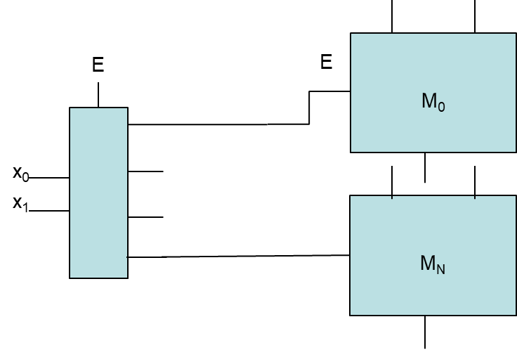
Decoders applications

Slide 5
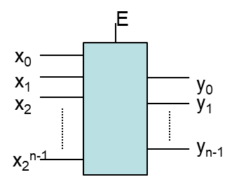
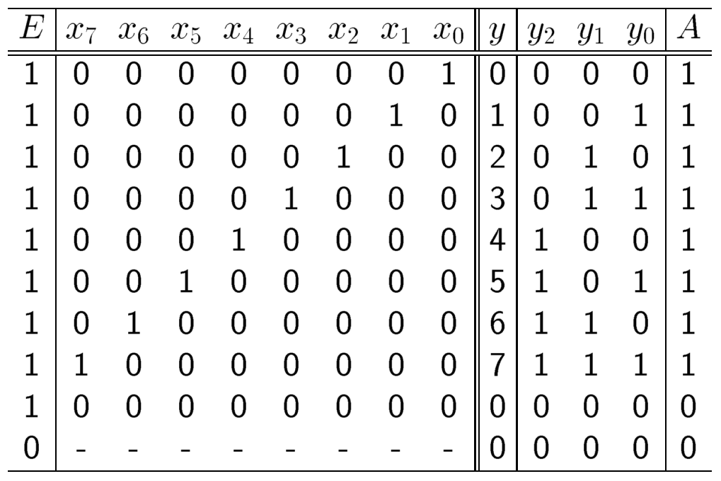
Encoder 1/2
A n-bit decoder is a combinational system having
2^{N} binary inputs X=( x₂^{n-1}….x₀)
N binary outputs Y=( y_{n-1}….y₀)
An input signal E (enable)
An additional Active output (optional)
It performs the inverse operation of a decoder

Slide 6
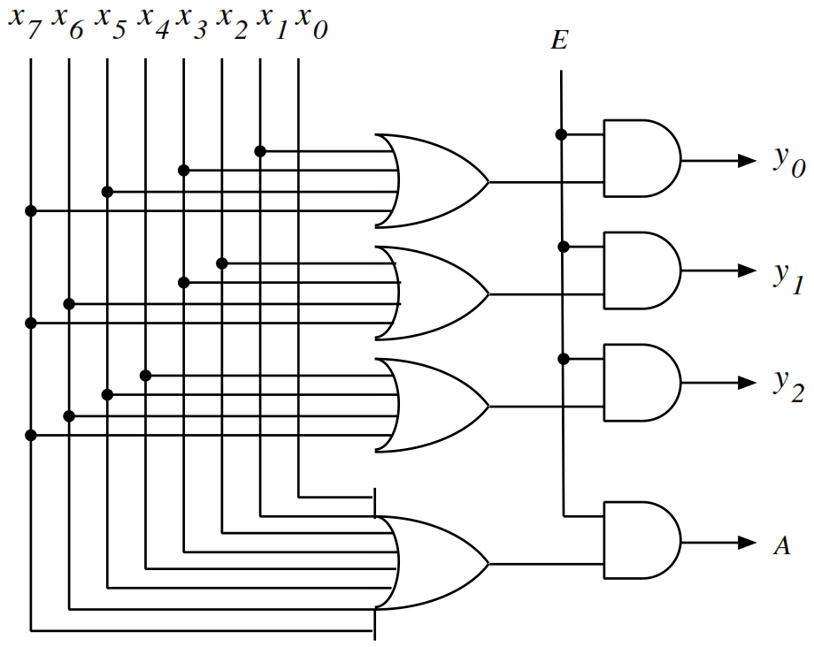
Encoder 2/2

Slide 7
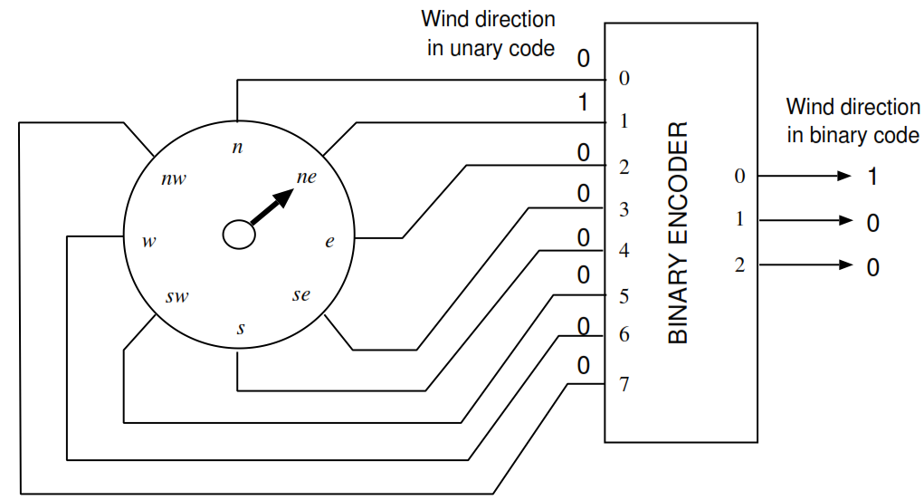
Encoder applications

Slide 8
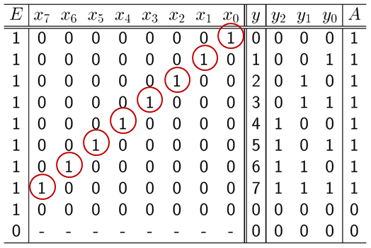
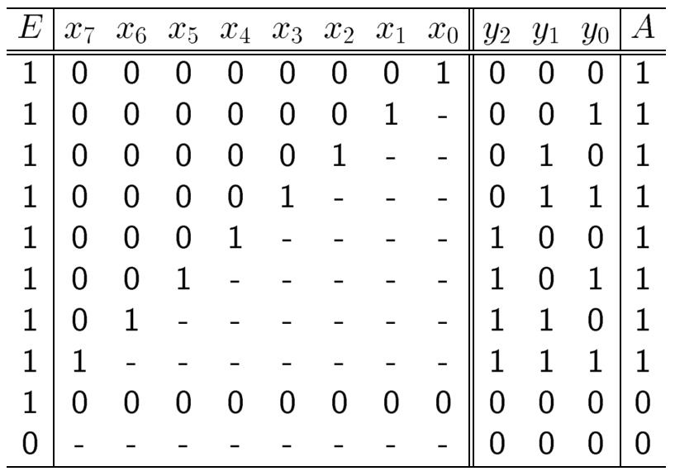
Priority Encoder
In a Binary encoders only one input may have the value 1
Priority encoders solve this limitation

Slide 9
Priority Encoder applications
Encoders used in interrupts

Slide 10
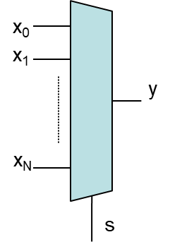
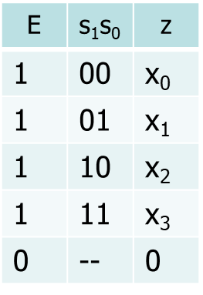
Multiplexer 1/2
A n-bit multiplexer is a combinational system having
N binary inputs X=( x_{n}….x₀)
A binary outputs y
A log₂(N) bit selector
An additional enable

Slide 11
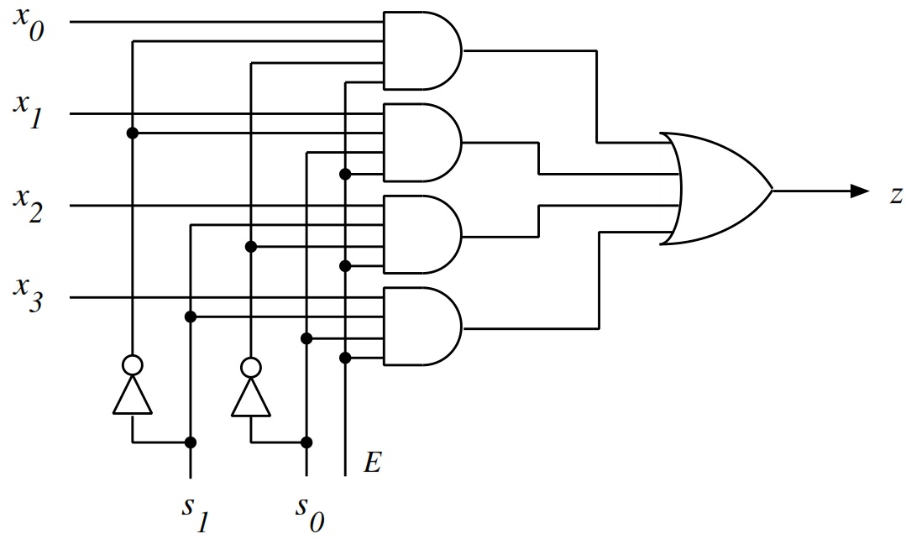
Multiplexer 2/2

Slide 12
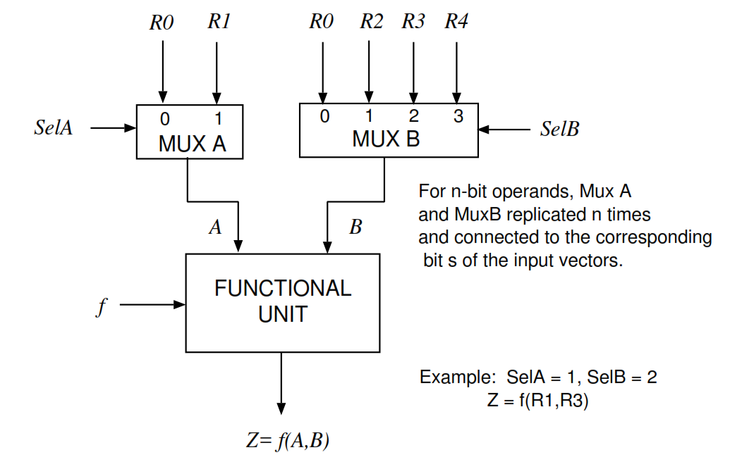
Multiplexer applications

Slide 13
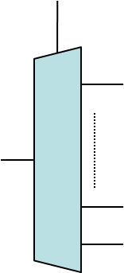
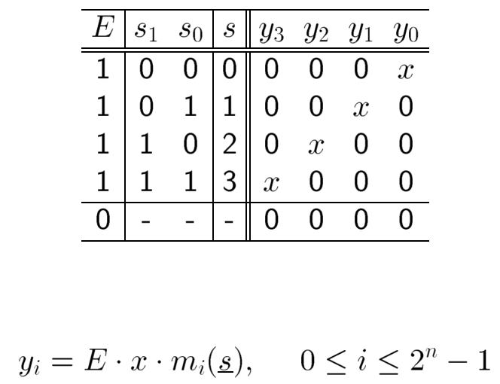
Demultiplexer 1/2
A n-bit demultiplexer is a combinational system having
A binary input x
N binary outputs Y=( y_{n}….y₀)
A log₂(N) bit selector
An additional enable

Slide 14
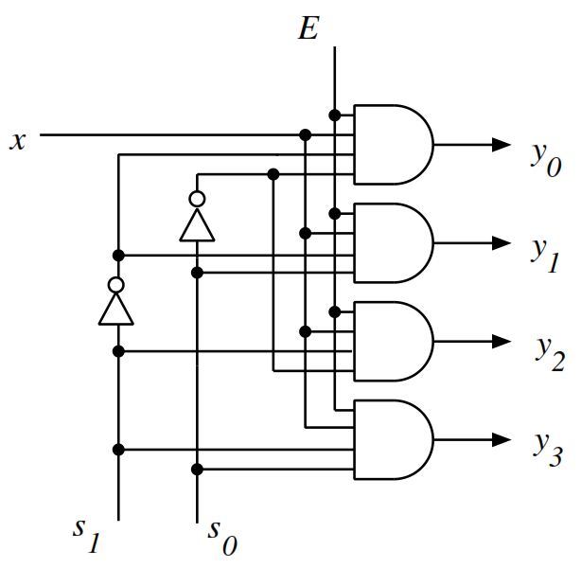
Demultiplexer 2/2

Slide 15
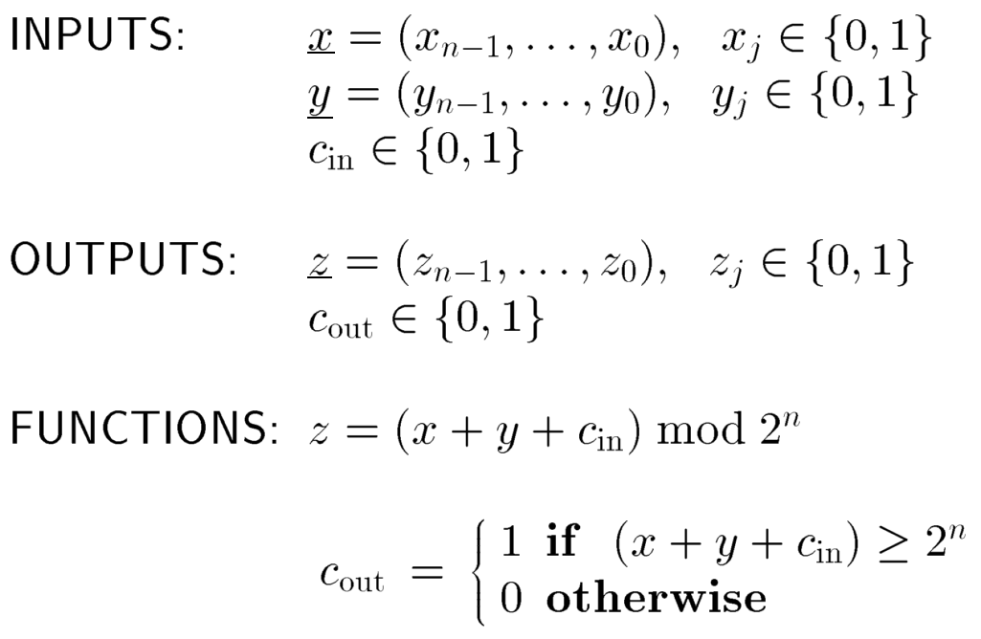
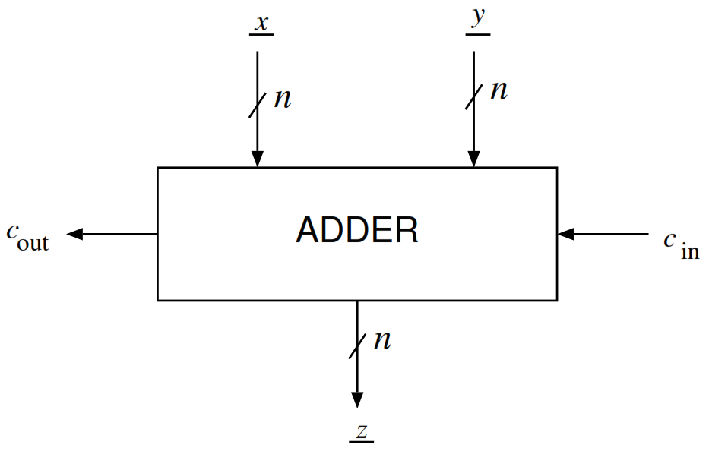
Adder

Slide 16
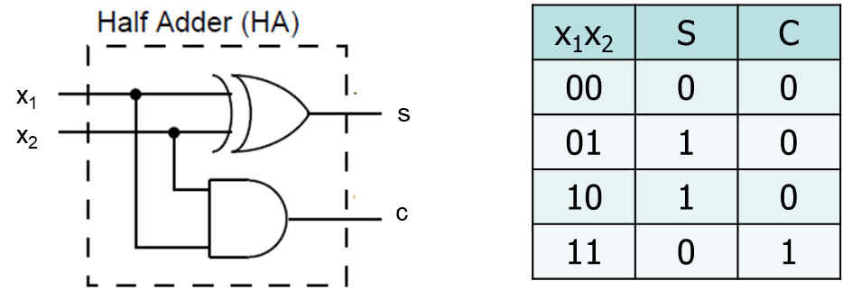
Half adder
Let’s suppose that we have to add only a bit

Slide 17
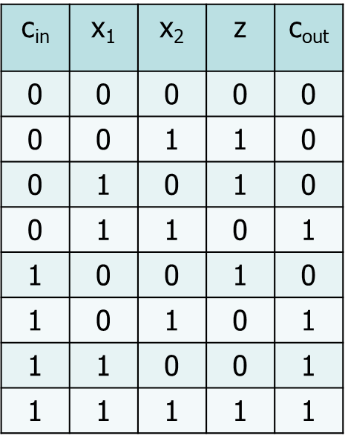
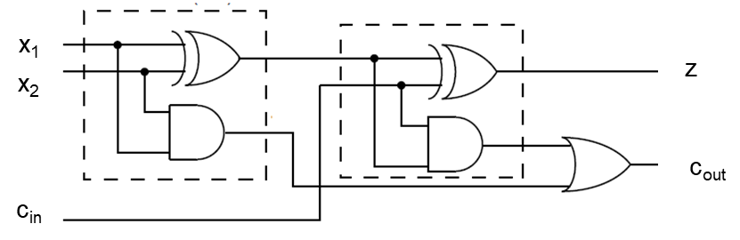
Full adder
Half adder doesn’t consider any Carry input
A complete 1 bit adder can be obtained combining two Half Adder
The complete 1 bit adder is called Full Adder

Slide 18
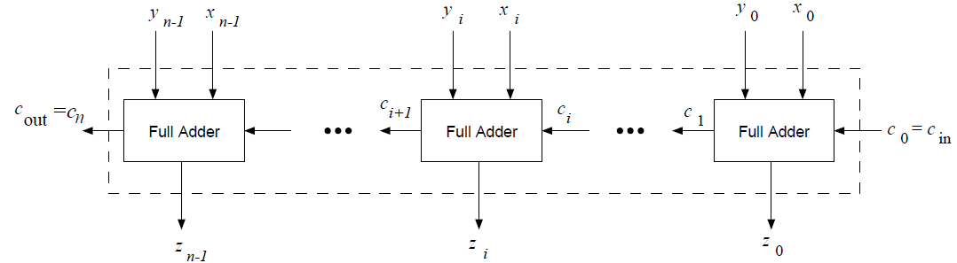
Carry-ripple adder
Multi-bit adders can be obtained using different approaches
Among these approaches the simplest is the carry-ripple circuit

Slide 19
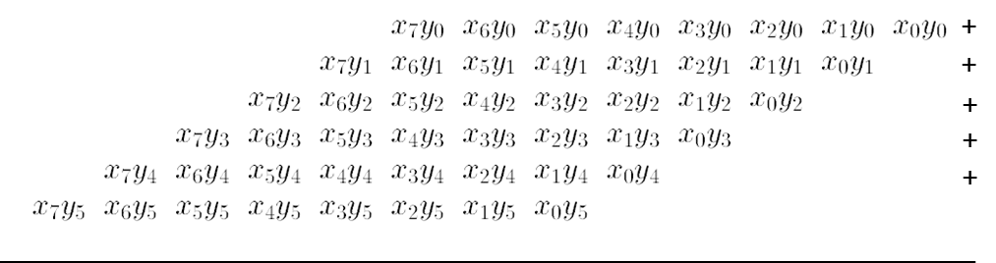
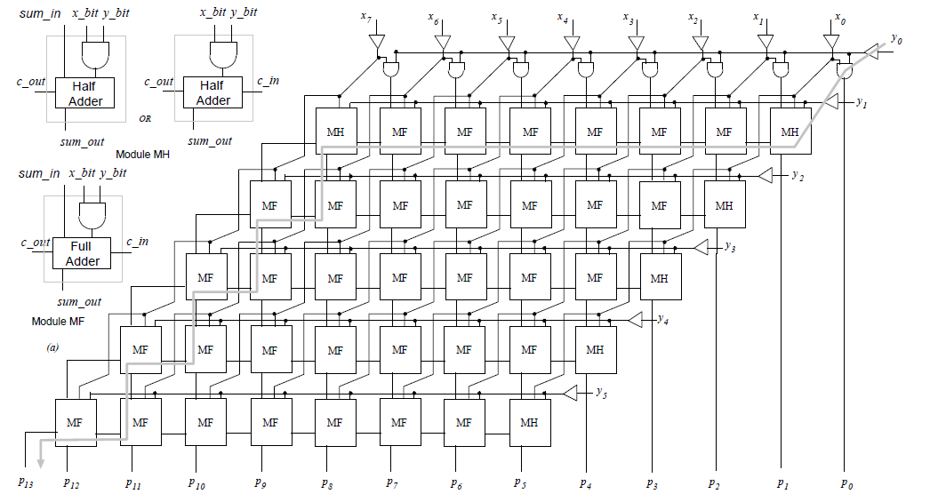
Multiplier
X: 8 bit number
Y: 6 bit number

